Slide 1
Computational Model and Algorithmic Technique
Dr. Han Huang
South China University of Technology

Slide 2


Chapter 8
Dynamic Programming
Copyright © 2007 Pearson Addison-Wesley. All rights reserved.

Slide 3
Dynamic Programming
Dynamic Programming is a general algorithm design technique for solving problems defined by recurrences with overlapping subproblems
Invented by American mathematician Richard Bellman in the 1950s to solve optimization problems and later assimilated by CS
“Programming” here means “planning”
Main idea:
    set up a recurrence relating a solution to a larger instance to solutions of some smaller instances
    - solve smaller instances once
    record solutions in a table
    extract solution to the initial instance from that table

Slide 4
Example: Fibonacci numbers
Recall definition of Fibonacci numbers:
  F(n) = F(n-1) + F(n-2)
  F(0) = 0
  F(1) = 1
Computing the n^{th} Fibonacci number recursively (top-down):
F(n)
F(n-1) + F(n-2)
F(n-2) + F(n-3) F(n-3) + F(n-4)
...

Slide 5
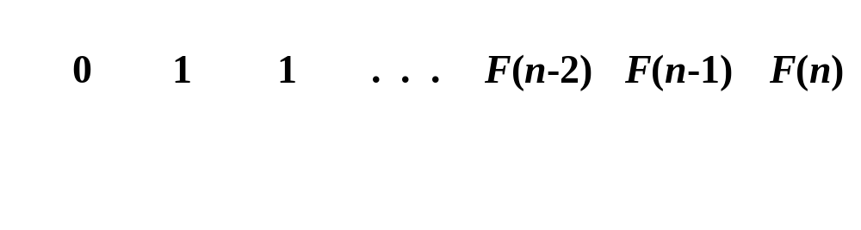
Example: Fibonacci numbers (cont.)
  Computing the n^{th} Fibonacci number using bottom-up iteration and recording results:
F(0) = 0
F(1) = 1
F(2) = 1+0 = 1
…
F(n-2) =
F(n-1) =
F(n) = F(n-1) + F(n-2)
Efficiency:
- time
- space

Slide 6
使用DP与递归法求解斐波那契数列的区别
  以n=5为例：
  若以DP求解斐波那契数列
  F(5) = F(4) + F(3)
  = (F(3) + F(2)) + (F(2) + F(1))
  …
  = 5*F(1) + 3*F(0)
  通过对数列的不断分解，只需进行两次乘法运算和一次加法运算；
  相对地如果通过递归法求解斐波那契数列
  F(5) = F(4) + F(3)
  …
  = (F(1) + F(0)) + F(1) + (F(1) + F(0)) + (F(1) + F(0)) + F(1)
  递归法求解时，对相似的子问题进行了重复计算，效率不高
  总体来说n不大时可以使用递归法，但是n较大后需要使用DP等方法求解效率更高

Slide 7
动态规划与递归法
  递归算法：就是通过解决同一问题的一个或多个更小的实例来最终解决一个大问题的算法。在使用递归程序时，需要保持一个其大小与递归深度成正比例的下推栈，问题规模越大递归算法求解效率越低。
  DP：我们可以按照从最小开始的顺序计算所有函数值来求任何类似函数的值，在每一步使用先前已经计算出的值来计算当前值，我们称这项技术为自底向上的动态规划。只要有存储已经计算出的值的空间，就能把这项技术应用到任何递归计算中，就能把算法从指数级运行时间向线性运行时间改进。
  自顶向下的动态规划：通过递归程序来存储它所计算的每一个值，并通过检查所存储的值，来避免重新计算它们的任何项。这种方法有时也称作为备忘录法(记忆化搜索)。

Slide 8
Examples of DP algorithms
Computing a binomial coefficient
Warshall’s algorithm for transitive closure
Floyd’s algorithm for all-pairs shortest paths
Constructing an optimal binary search tree
Some instances of difficult discrete optimization problems:
  - traveling salesman
  - knapsack

Slide 9
8.1 Computing a Binomial Coefficient

Slide 10
Computing a binomial coefficient by DP
  Binomial coefficients are coefficients of the binomial formula:
  (a + b)^{n} = C(n,0)a^{n}b⁰ + . . . + C(n,k)a^{n-k}b^{k} + . . . + C(n,n)a⁰b^{n}
  Recurrence: C(n,k) = C(n-1,k) + C(n-1,k-1) for n > k > 0
  C(n,0) = 1, C(n,n) = 1 for n ≥ 0
  Value of C(n,k) can be computed by filling a table:
  0 1 2 . . . k-1 k
  0 1
  1 1 1
  .
  .
  .
  n-1 C(n-1,k-1) C(n-1,k)
  n C(n,k)

Slide 11
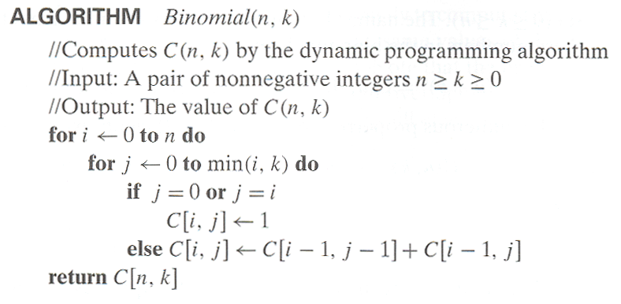
Computing C(n,k): pseudocode and analysis
计算C[i,j]时不需要从头开始算，节省了遍历计算C[i,j]的算力
Step1：初始化最边缘和对角的组合数值C(k,0),C(k,k)为1
Step2：通过组合数递推式计算其他组合数的值
Step3：返回结果

Slide 12
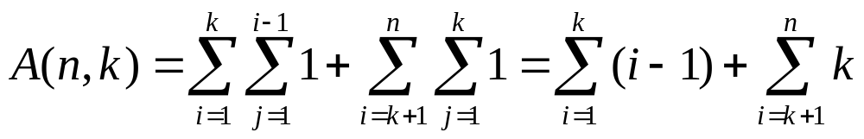
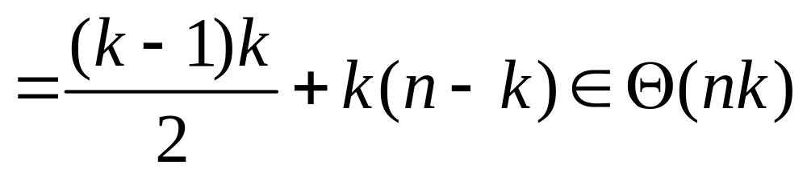
Efficiency Analysis
Time efficiency: Θ(nk)
Space efficiency: Θ(nk)

Slide 13
8.2 Warshall’s and Floyd’s Algorithm

Slide 14
Warshall’s Algorithm: Transitive Closure
Computes the transitive closure of a relation
Alternatively: existence of all nontrivial paths in a digraph
Example of transitive closure:
3
3
1
1
4
4
0 0 1 0
1 1 1 1
0 0 0 0
1 1 1 1
2
0 0 1 0
1 0 0 1
0 0 0 0
0 1 0 0
2

Slide 15
Warshall’s Algorithm
Constructs transitive closure T as the last matrix in the sequence of n-by-n matrices R⁽⁰⁾, … , R^{(k)}, … , R^{(n)} where
R^{(k)}[i,j] = 1 if there is nontrivial path from i to j with only first k vertices allowed as intermediate
Note that R⁽⁰⁾ = A (adjacency matrix), R^{(n)} = T (transitive closure)
3
3
3
3
3
1
1
1
1
1
4
4
4
2
4
4
2
2
2
2
R⁽⁰⁾
0 0 1 0
1 0 0 1
0 0 0 0
0 1 0 0
R⁽¹⁾
0 0 1 0
1 0 1 1
0 0 0 0
0 1 0 0
R⁽²⁾
0 0 1 0
1 0 1 1
0 0 0 0
1 1 1 1
R⁽³⁾
0 0 1 0
1 0 1 1
0 0 0 0
1 1 1 1
R⁽⁴⁾
0 0 1 0
1 1 1 1
0 0 0 0
1 1 1 1

Slide 16
Warshall’s Algorithm (recurrence)
On the k-th iteration, the algorithm determines for every pair of vertices i, j if a path exists from i and j with just vertices 1,…,k allowed as intermediate
        R^{(k-1)}[i,j] (path using just 1 ,…,k-1)
R^{(k)}[i,j] = or
      R^{(k-1)}[i,k] and R^{(k-1)}[k,j] (path from i to k
      and from k to i
      using just
      1 ,…,k-1)
{
k
i
j

Slide 17
Warshall’s Algorithm (matrix generation)
Recurrence relating elements R^{(k)} to elements of R^{(k-1)} is:
      R^{(k)}[i,j] = R^{(k-1)}[i,j] or (R^{(k-1)}[i,k] and R^{(k-1)}[k,j])
It implies the following rules for generating R^{(k)} from R^{(k-1)}:
Rule 1 If an element in row i and column j is 1 in R^{(k-1)},
it remains 1 in R^{(k)}
Rule 2 If an element in row i and column j is 0 in R^{(k-1)},
it has to be changed to 1 in R^{(k)} if and only if
the element in its row i and column k and the element in its column j and row k are both 1’s in R^{(k-1)}

Slide 18
Warshall’s Algorithm (example)
3
1
0 0 1 0
1 0 0 1
0 0 0 0
0 1 0 0
0 0 1 0
1 0 1 1
0 0 0 0
0 1 0 0
R⁽⁰⁾ ⁼
R⁽¹⁾ ⁼
4
2
0 0 1 0
1 0 1 1
0 0 0 0
1 1 1 1
0 0 1 0
1 0 1 1
0 0 0 0
1 1 1 1
0 0 1 0
1 1 1 1
0 0 0 0
1 1 1 1
R⁽²⁾ ⁼
R⁽³⁾ ⁼
R⁽⁴⁾ ⁼

Slide 19
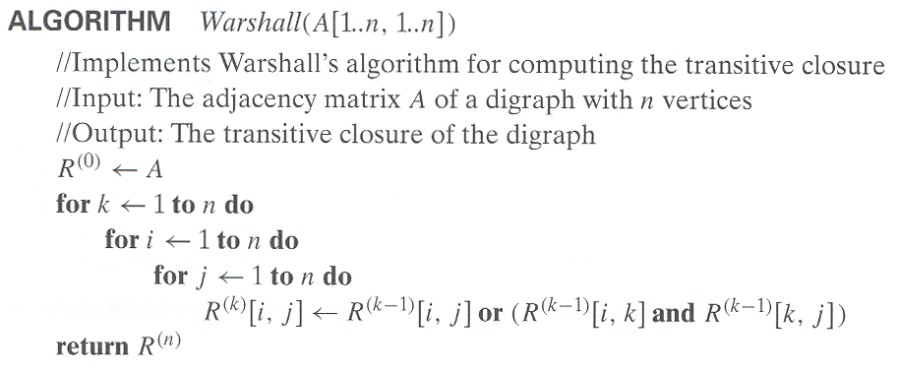
Warshall’s Algorithm (pseudocode and analysis)
通过递推式计算其他R矩阵的值
计算R^{(k)}[i,j]时不需要从头开始算，节省了遍历计算R^{(k)}[i,j]的算力

Slide 20
Warshall’s Algorithm (pseudocode and analysis)
计算R^{(k)}[i,j]时不需要从头开始算，节省了遍历计算R^{(k)}[i,j]的算力
通过递推式计算其他R矩阵的值
Time efficiency: Θ(n³)
Space efficiency: Matrices can be written over their predecessors

Slide 21
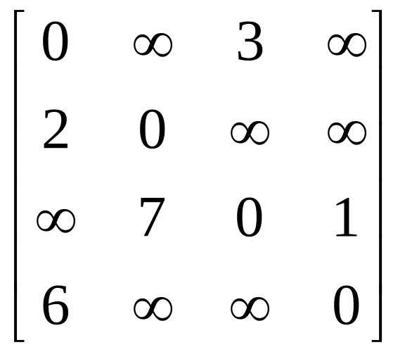
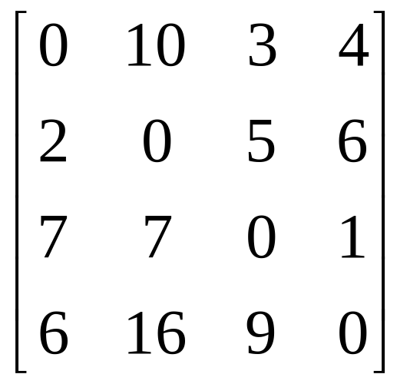
Floyd’s Algorithm
Draw a graph with the adjacency matrix
a
b
c
d

Slide 22
Floyd’s Algorithm: All pairs shortest paths
Problem: In a weighted (di)graph, find shortest paths between every pair of vertices
Same idea: construct solution through series of matrices D⁽⁰⁾, …, D ^{(n)} using increasing subsets of the vertices allowed as intermediate
Example:
4
3
1
1
6
1
5
4
2
3

Slide 23
Floyd’s Algorithm (matrix generation)
On the k-th iteration, the algorithm determines shortest paths between every pair of vertices i, j that use only vertices among 1,…,k as intermediate
D^{(k)}[i,j] = min {D^{(k-1)}[i,j], D^{(k-1)}[i,k] + D^{(k-1)}[k,j]}
D^{(k-1)}[i,k]
k
i
D^{(k-1)}[k,j]
D^{(k-1)}[i,j]
j

Slide 24
Floyd’s Algorithm (example)
2
1
2
3
6
7
0 ∞ 3 ∞
2 0 ∞ ∞
∞ 7 0 1
6 ∞ ∞ 0
0 ∞ 3 ∞
2 0 5 ∞
∞ 7 0 1
6 ∞ 9 0
3
1
4
D⁽⁰⁾ ⁼
D⁽¹⁾ ⁼
0 ∞ 3 ∞
2 0 5 ∞
9 7 0 1
6 ∞ 9 0
0 10 3 4
2 0 5 6
9 7 0 1
6 16 9 0
0 10 3 4
2 0 5 6
7 7 0 1
6 16 9 0
D⁽²⁾ ⁼
D⁽³⁾ ⁼
D⁽⁴⁾ ⁼

Slide 25
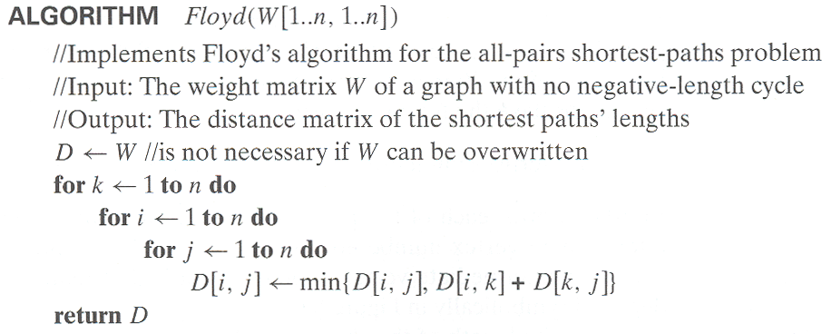
Floyd’s Algorithm (pseudocode and analysis)
通过递推式计算其他D矩阵的值
计算D[i,j]时不需要从头开始算，节省了遍历计算D[i,j]的算力

Slide 26
Floyd’s Algorithm (pseudocode and analysis)
计算D[i,j]时不需要从头开始算，节省了遍历计算D[i,j]的算力
通过递推式计算其他D矩阵的值
Time efficiency: Θ(n³)
Space efficiency: Matrices can be written over their predecessors
Note: Shortest paths themselves can be found, too

Slide 27
8.3 Optimal Binary Search Trees

Slide 28
Optimal Binary Search Trees
Problem: Given n keys a₁ < …< a_{n} and probabilities p₁ ≤ … ≤ p_{n} searching for them, find a BST with a minimum average number of comparisons in successful search.
Since total number of BSTs with n nodes is given by C(2n,n)/(n+1), which grows exponentially, brute force is hopeless.
Example: What is an optimal BST for keys A, B, C, and D with search probabilities 0.1, 0.2, 0.4, and 0.3, respectively?

Slide 29
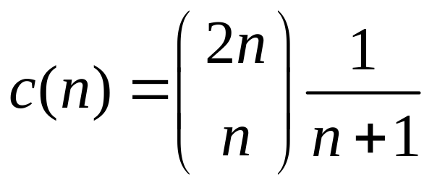
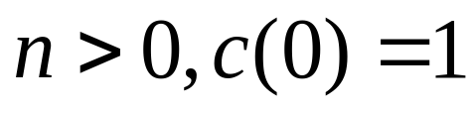
Two possible examples of A,B,C,D
A
Catalan number
B
B
C
A
C
D
D
ak
Optimal BST for ai,…,ak-1
Optimal BST for ak+1,…,aj

Slide 30
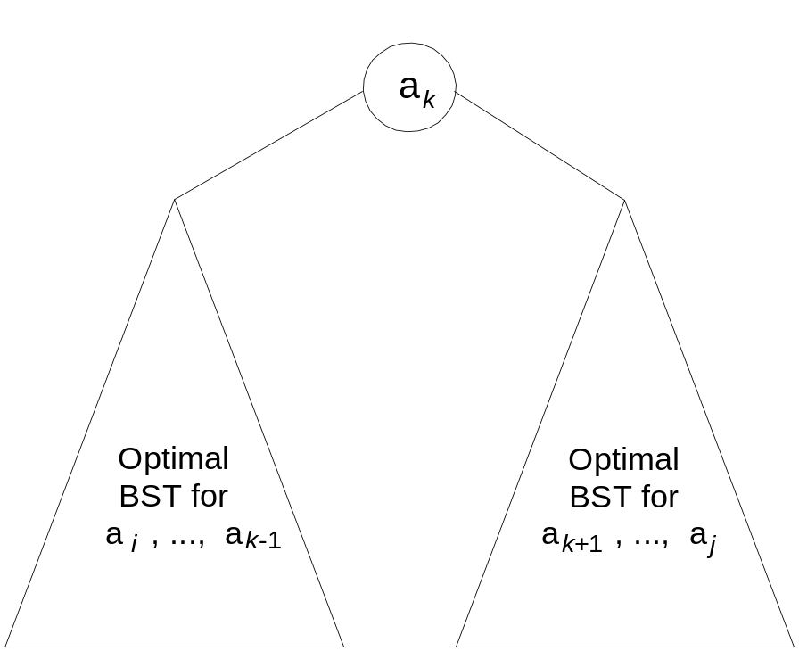
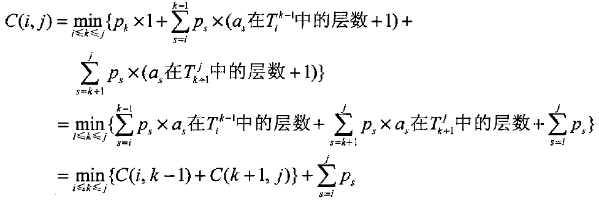
DP for Optimal BST Problem
Let C[i,j] be minimum average number of comparisons made in T[i,j], optimal BST for keys a_{i} < …< a_{j} , where 1 ≤ i ≤ j ≤ n. Consider optimal BST among all BSTs with some a_{k} (i ≤ k ≤ j ) as their root; T[i,j] is the best among them.

Slide 31
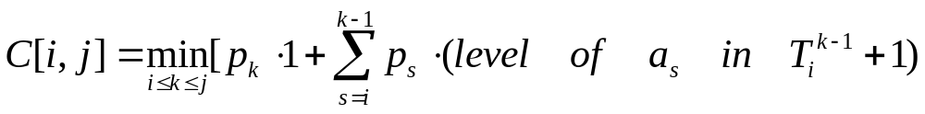
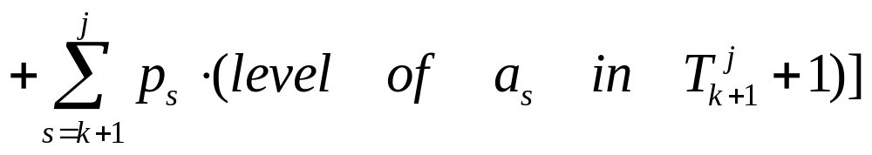
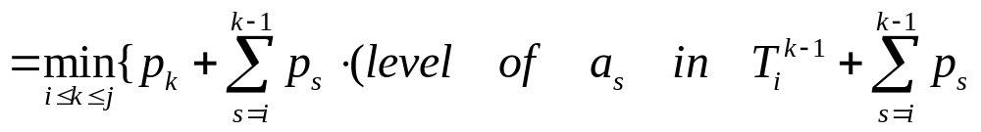
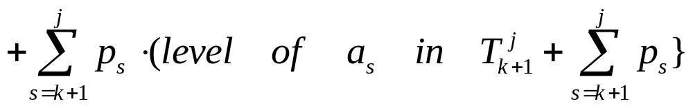
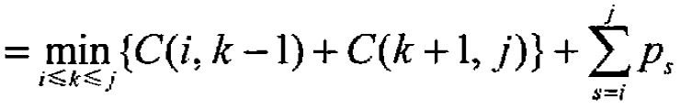
Recurrence Relation

Slide 32
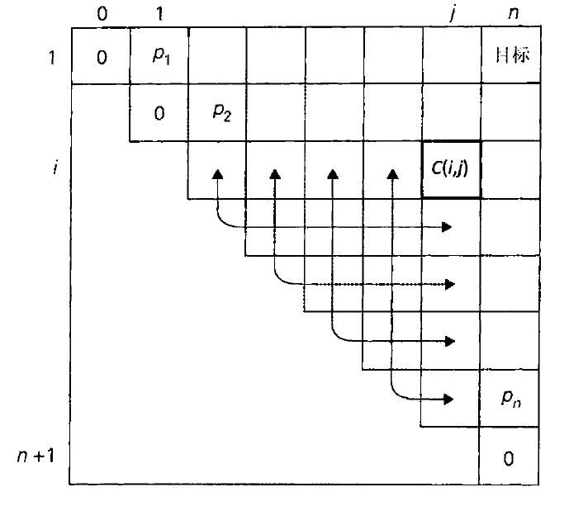
DP for Optimal BST Problem (cont.)
After simplifications, we obtain the recurrence for C[i,j]:
C[i,j] = min {C[i,k-1] + C[k+1,j]} + ∑ p_{s} for 1 ≤ i ≤ j ≤ n，
C[i,i-1] = 0
C[i,i] = p_{i} for 1 ≤ i ≤ n
j
s = i
1≤ i ≤ n+1

Slide 33
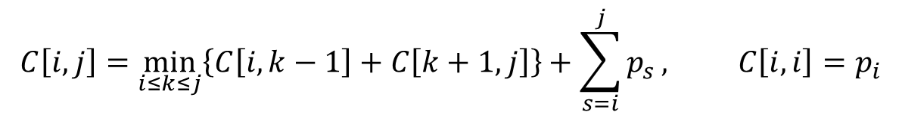
Example: key A B C D
probability 0.1 0.2 0.4 0.3
The tables below are filled diagonal by diagonal: the left one is filled using the recurrence
the right one, for trees’ roots, records k’s values giving the minima
_{i} ^{j}
 | 0 | 1 | 2 | 3 | 4
1 | 0 | .1 | .4 | 1.1 | 1.7
2 |  | 0 | .2 | .8 | 1.4
3 |  |  | 0 | .4 | 1.0
4 |  |  |  | 0 | .3
5 |  |  |  |  | 0
_{i} ^{j}
 | 0 | 1 | 2 | 3 | 4
1 |  | 1 | 2 | 3 | 3
2 |  |  | 2 | 3 | 3
3 |  |  |  | 3 | 3
4 |  |  |  |  | 4
5
C
B
D
A
optimal BST

Slide 34
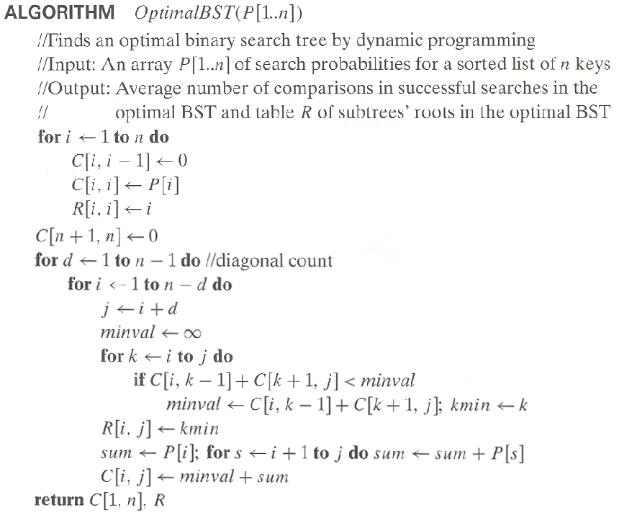
Optimal Binary Search Trees
Step1：初始化C对角元、C次对角元、R次对角元、C对角元最后一个元素
Step2：对所有节点进行范围搜索，并在最开始记录范围和当前根k的最小评价比较次数
Step3：将二叉树看做是两个子树进行比较，如果最小评价比较次数更少则更新
计算R[i,j],C[i,j]时不需要从头开始算，节省了重复计算R[i,j],C[i,j]的算力

Slide 35
Analysis DP for Optimal BST Problem
Time efficiency: Θ(n³) but can be reduced to Θ(n²) by taking advantage of monotonicity of entries in the root table, i.e., R[i,j] is always in the range between R[i,j-1] and R[i+1,j]
Space efficiency: Θ(n²)
Method can be expended to include unsuccessful searches

Slide 36
8.4 Knapsack Problem and Memory Functions

Slide 37

Knapsack Problem by DP
Given n items of
  integer weights: w₁ w₂ … w_{n}
  values: v₁ v₂ … v_{n}
a knapsack of integer capacity W
find most valuable subset of the items that fit into the knapsack
Consider instance defined by first i items and capacity j (j ≤ W).
Let F[i,j] be optimal value of such instance. Then
Initial conditions: F[0,j] = 0 and F[i,0] = 0

Slide 38
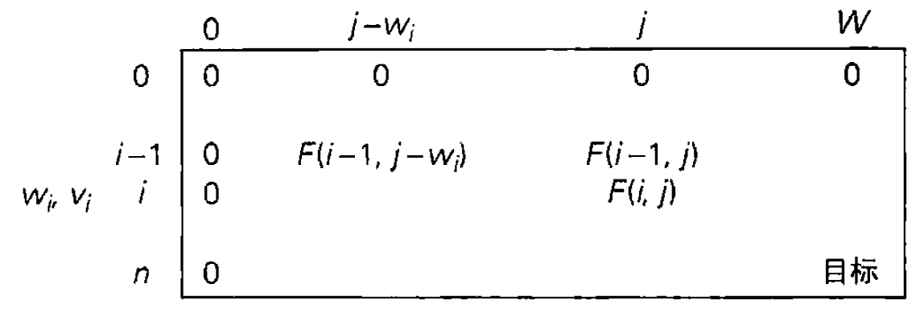
Knapsack Problem by DP

Slide 39
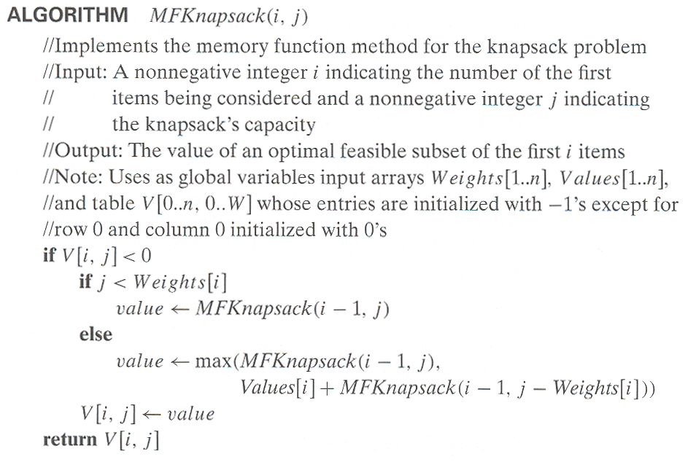
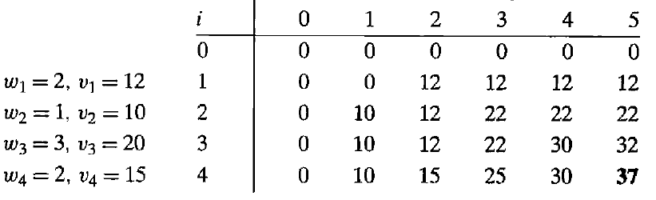
Knapsack Problem by DP (example)
Example: Knapsack of capacity W = 5
item weight value
1 2 $12
2 1 $10
3 3 $20
4 2 $15

Slide 40
Step1:记录前i-1件物品中选取若干件物品放入剩余空间为j的背包中所能得到的最大价值
Step2:比较“前i-1件物品中选取若干件物品放入剩余空间为j-C[i]的背包中所能取得的最大价值加上第i件物品的价值之和”与“Step1”计算的最大价值，取更大者

Slide 41
Step1:记录前i-1件物品中选取若干件物品放入剩余空间为j的背包中所能得到的最大价值
计算V[i,j]时不需要从头开始算，节省了重复计算V[i,j]的算力
Step2:比较“前i-1件物品中选取若干件物品放入剩余空间为j-C[i]的背包中所能取得的最大价值加上第i件物品的价值之和”与“Step1”计算的最大价值，取更大者

Slide 42
Application

Slide 43
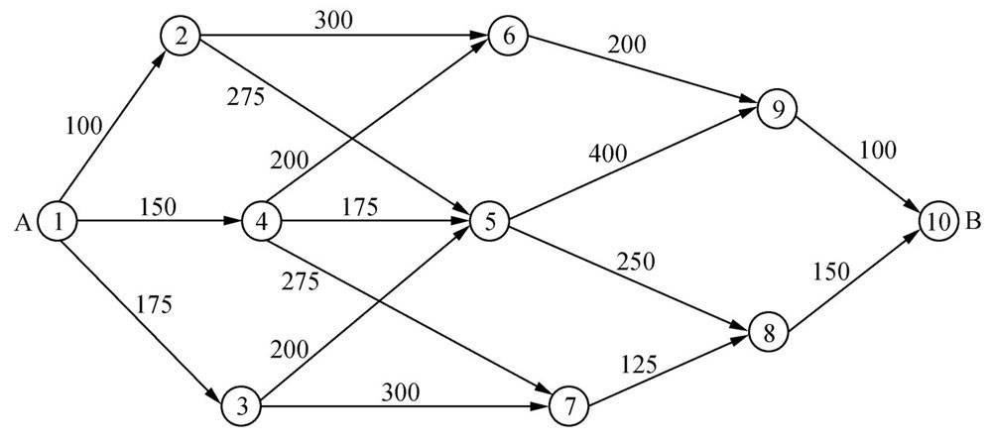
配送运输规划中最短路线问题-Floyd’s Algorithm
在配送运输规划中经常需要寻找一条最优的运输路线，以便路线最短，费用最省。这时候就可以用到最短路算法。如下图，要把A市的一批货物运送到B市，最优的路线是那条呢？

Slide 44
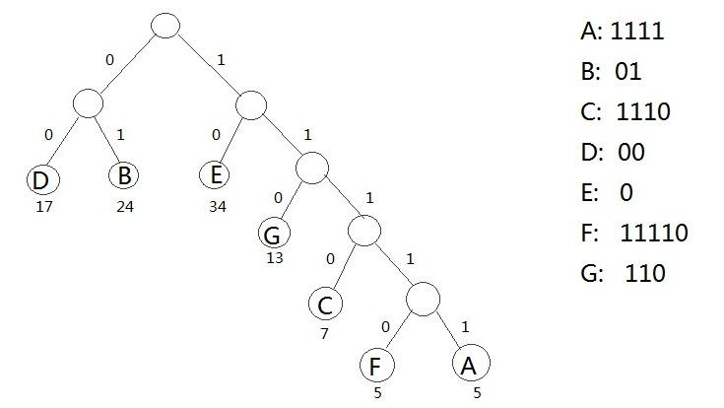
数据通讯的编码问题——Huffman编码
在电文收发等数据通讯中，通过0、1信号传输信息。
各个字符的出现频率不相同。
出现频率大 → 短编码
出现频率小 → 长编码
字符序列的编码总长度最短

Slide 45
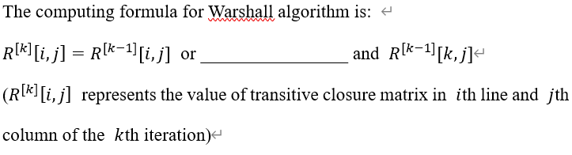

Exercise

Slide 46
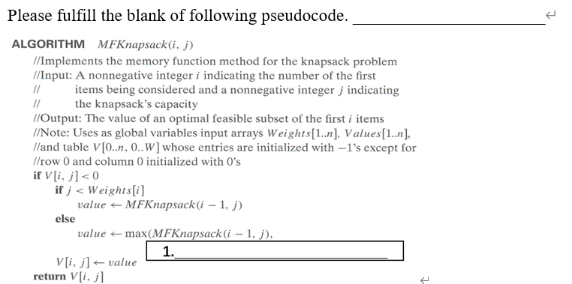
Exercise

Slide 47
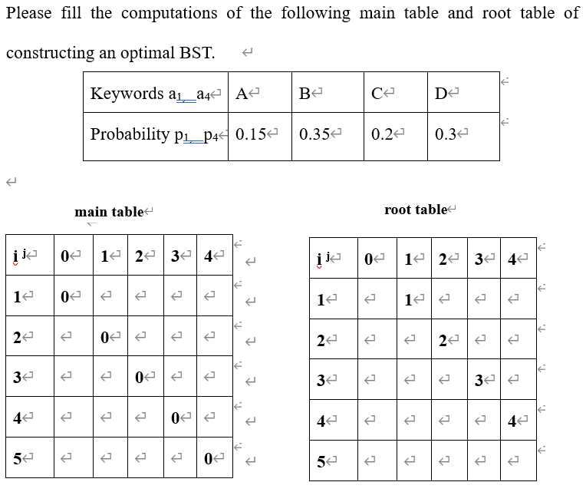
Exercise

Slide 48
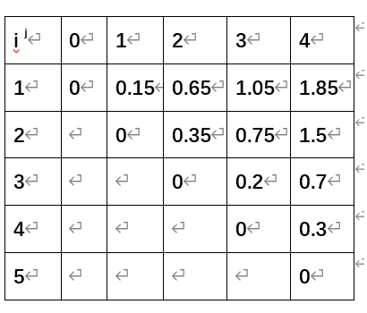
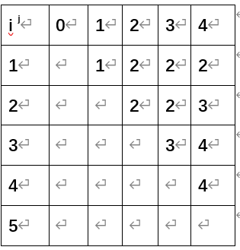
Exercise

Slide 49
End of the Section 8
Click to edit company slogan .

